Slide 1
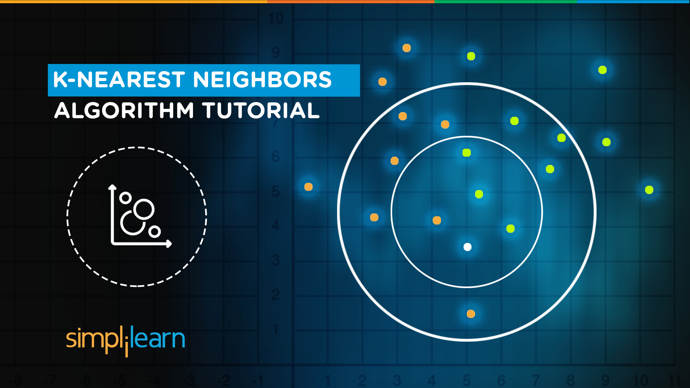


KNN Classification Algorithm

Slide 2

What’s in it for you?
Why do we need KNN?
What is KNN?
How do we choose the factor ‘K’?
When do we use KNN?
How does KNN Algorithm work?
Use Case: Predict whether a person will have diabetes or not
Notes:
Remove title case

Slide 3

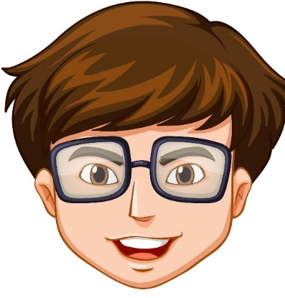
Why KNN?
By now, we all know Machine learning models makes predictions by learning from the past data available
Machine Learning Model
Input value
Predicted Output
Notes:
,. Unlike other regression algorithms where we have one or more than one dependent variables

Slide 4


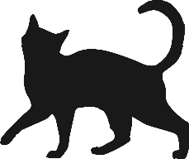
Is that a dog?
Notes:
,. Unlike other regression algorithms where we have one or more than one dependent variables

Slide 5
No dear, you can differentiate between a cat and a dog based on their characteristics
Notes:
,. Unlike other regression algorithms where we have one or more than one dependent variables

Slide 6

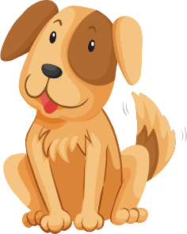
No dear, you can differentiate between a cat and a dog based on their characteristics
CATS
DOGS
Sharp Claws, uses to climb
Smaller length of ears
Meows and purrs
Doesn’t love to play around
Dull Claws
Bigger length of ears
Barks
Loves to run around
Notes:
,. Unlike other regression algorithms where we have one or more than one dependent variables

Slide 7

No dear, you can differentiate between a cat and a dog based on their characteristics
CATS
DOGS
Sharpness of claws →
Length of ears →
Notes:
,. Unlike other regression algorithms where we have one or more than one dependent variables

Slide 8
Now tell me if it is a cat or a dog?
Notes:
,. Unlike other regression algorithms where we have one or more than one dependent variables

Slide 9
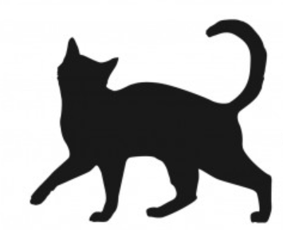
Now tell me if it’s a cat or a dog?
CATS
DOGS
Sharpness of claws →
Length of ears →
Notes:
,. Unlike other regression algorithms where we have one or more than one dependent variables

Slide 10
It’s features are more like cats, it must be a cat!
Notes:
,. Unlike other regression algorithms where we have one or more than one dependent variables

Slide 11
CATS
DOGS
Sharp of claws →
Length of ears →
Notes:
,. Unlike other regression algorithms where we have one or more than one dependent variables

Slide 12

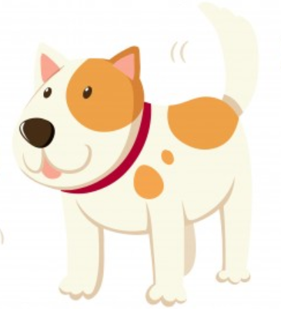
Why KNN?
Because KNN is based on feature similarity, we can do classification using KNN Classifier!
KNN
Input value
Predicted Output
Notes:
,. Unlike other regression algorithms where we have one or more than one dependent variables

Slide 13
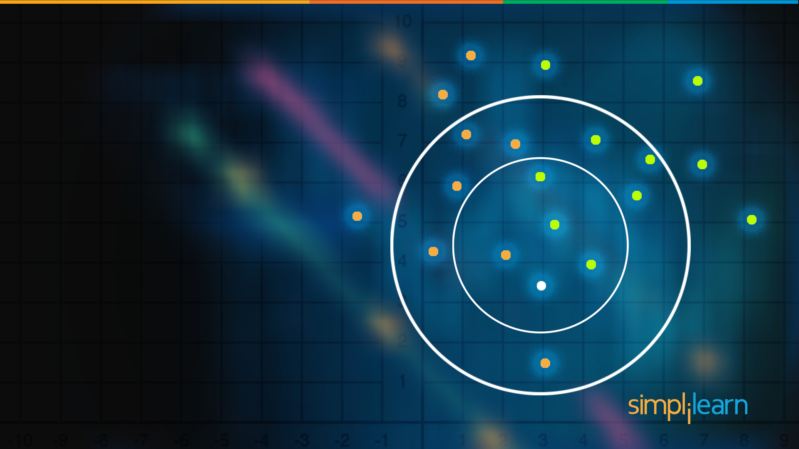
What is KNN?

Slide 14

What is KNN Algorithm?
KNN – K Nearest Neighbors, is one of the simplest Supervised Machine Learning algorithm mostly used for
Classification
It classifies a data point based on how its neighbors are classified
Notes:
,. Unlike other regression algorithms where we have one or more than one dependent variables

Slide 15

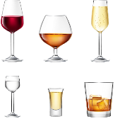


What is KNN Algorithm?
KNN stores all available cases and classifies new cases based on a similarity measure
Sulphur Dioxide Level →
RED or WHITE?
Chloride Level →
Notes:
,. Unlike other regression algorithms where we have one or more than one dependent variables

Slide 16

What is KNN Algorithm?
But, what is K?
Sulphur Dioxide Level →
RED or WHITE?
Chloride Level →
Notes:
,. Unlike other regression algorithms where we have one or more than one dependent variables

Slide 17
What is KNN Algorithm?
k in KNN is a parameter that refers to the number of nearest neighbors to include in the majority voting process
K=5
Sulphur Dioxide Level →
RED or WHITE?
Chloride Level →
Notes:
,. Unlike other regression algorithms where we have one or more than one dependent variables

Slide 18
What is KNN Algorithm?
A data point is classified by majority votes from its 5 nearest neighbors
K=5
Sulphur Dioxide Level →
RED or WHITE?
Chloride Level →
Notes:
,. Unlike other regression algorithms where we have one or more than one dependent variables

Slide 19
What is KNN Algorithm?
Here, the unknown point would be classified as red, since 4 out of 5 neighbors are red
K=5
Sulphur Dioxide Level →
RED
Chloride Level →
Notes:
,. Unlike other regression algorithms where we have one or more than one dependent variables

Slide 20
How do we choose ‘k’?

Slide 21
How do we choose the factor ‘k’?
KNN Algorithm is based on feature similarity: Choosing the right value of k is a process called parameter tuning, and is important for better accuracy
K=3
?
New Variable

Slide 22
How do we choose the factor ‘k’?
KNN Algorithm is based on feature similarity: Choosing the right value of k is a process called parameter tuning, and is important for better accuracy
k=3
?
New Variable
So at k=3, we can classify ‘?’ as

Slide 23
How do we choose the factor ‘k’?
KNN Algorithm is based on feature similarity: Choosing the right value of k is a process called parameter tuning, and is important for better accuracy
k=7
k=3
?
New Variable
But at k=7, we classify ‘?’ as

Slide 24

How do we choose the factor ‘k’?
KNN Algorithm is based on feature similarity: Choosing the right value of k is a process called parameter tuning, and is important for better accuracy
The class of unknown data point was at k=3 but changed at k=7, so which k should we choose?
K=3
K=1
?
New Variable
So at k=3, we can classify ‘?’ as

Slide 25
How do we choose the factor ‘k’?
To choose a value of k:
Sqrt(n), where n is the total number of data points
Odd value of K is selected to avoid confusion between two classes of data

Slide 26

How do we choose the factor ‘k’?
Higher value of k has lesser chance of error
To choose a value of k:
Sqrt(n), where n is the total number of data points
Odd value of K is selected to avoid confusion between two classes of data

Slide 27
When do we use KNN?

Slide 28


When do we use KNN Algorithm?
Data is labeled
We can use KNN when
Dog
Notes:
,. Unlike other regression algorithms where we have one or more than one dependent variables
We have a small data set as KNN is a lazy learner so it becomes slow with large datasets

Slide 29
When do we use KNN Algorithm?
Data is labeled
We can use KNN when
Dog
Data is noise free
Weight(x2) | Height(y2) | Class
51 | 167 | Underweight
62 | 182 | one-fourty
69 | 176 | 23
64 | 173 | hello kitty
65 | 172 | Normal
Noise
Notes:
,. Unlike other regression algorithms where we have one or more than one dependent variables
We have a small data set as KNN is a lazy learner so it becomes slow with large datasets

Slide 30

When do we use KNN Algorithm?
Data is labeled
We can use KNN when
Dog
Dataset is small
Data is noise free
Weight(x2) | Height(y2) | Class
51 | 167 | Underweight
62 | 182 | one-fourty
69 | 176 | 23
64 | 173 | hello kitty
65 | 172 | Normal
Because KNN is a ‘lazy learner’ i.e. doesn’t learn a discriminative function from the training set
Noise
Notes:
,. Unlike other regression algorithms where we have one or more than one dependent variables
We have a small data set as KNN is a lazy learner so it becomes slow with large datasets

Slide 31
How does KNN Algorithm work?

Slide 32

How does KNN Algorithm work?
Consider a dataset having two variables: height (cm) & weight (kg) and each point is classified as Normal or Underweight
Weight(x2) | Height(y2) | Class
51 | 167 | Underweight
62 | 182 | Normal
69 | 176 | Normal
64 | 173 | Normal
65 | 172 | Normal
56 | 174 | Underweight
58 | 169 | Normal
57 | 173 | Normal
55 | 170 | Normal

Slide 33

How does KNN Algorithm work?
On the basis of the given data we have to classify the below set as Normal or Underweight using KNN
57 kg | 170 cm | ?
Assuming, we don’t know how to calculate BMI!

Slide 34

How does KNN Algorithm work?
To find the nearest neighbors, we will calculate Euclidean distance
But, what is Euclidean distance?

Slide 35
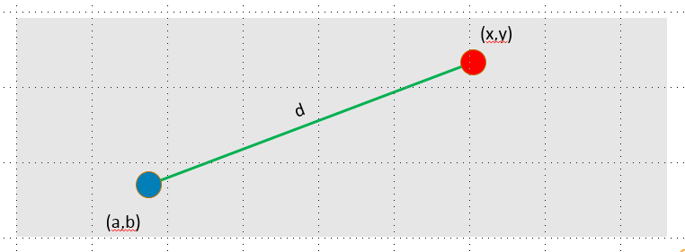
How does KNN Algorithm work?
According to the Euclidean distance formula, the distance between two points in the plane with coordinates (x, y) and (a, b) is given by:
dist(d)= √(x - a)² + (y - b)²

Slide 36
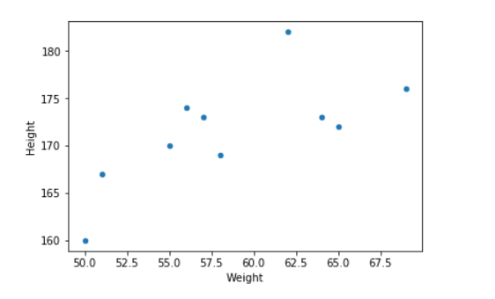
How does KNN Algorithm work?
Let’s calculate it to understand clearly:
dist(d1)= √(170-167)² + (57-51)² ~= 6.7
d2
d3
dist(d2)= √(170-182)² + (57-62)² ~= 13
d1
dist(d3)= √(170-176)² + (57-69)² ~= 13.4
Similarly, we will calculate Euclidean distance of unknown data point from all the points in the dataset
Unknown data point

Slide 37
How does KNN Algorithm work?
Hence, we have calculated the Euclidean distance of unknown data point from all the points as shown:
Weight(x2) | Height(y2) | Class | Euclidean Distance
51 | 167 | Underweight | 6.7
62 | 182 | Normal | 13
69 | 176 | Normal | 13.4
64 | 173 | Normal | 7.6
65 | 172 | Normal | 8.2
56 | 174 | Underweight | 4.1
58 | 169 | Normal | 1.4
57 | 173 | Normal | 3
55 | 170 | Normal | 2
Where (x1, y1) = (57, 170) whose class we have to classify

Slide 38
How does KNN Algorithm work?
Now, lets calculate the nearest neighbor at k=3
Weight(x2) | Height(y2) | Class | Euclidean Distance
51 | 167 | Underweight | 6.7
62 | 182 | Normal | 13
69 | 176 | Normal | 13.4
64 | 173 | Normal | 7.6
65 | 172 | Normal | 8.2
56 | 174 | Underweight | 4.1
58 | 169 | Normal | 1.4
57 | 173 | Normal | 3
55 | 170 | Normal | 2
k = 3
57 kg | 170 cm | ?

Slide 39
How does KNN Algorithm work?
Now, lets calculate the nearest neighbor at k=3
We have n=10,
And sqrt(10)=3.1
Hence, we have taken k=3
Weight(x2) | Height(y2) | Class | Euclidean Distance
51 | 167 | Underweight | 6.7
62 | 182 | Normal | 13
69 | 176 | Normal | 13.4
64 | 173 | Normal | 7.6
65 | 172 | Normal | 8.2
56 | 174 | Underweight | 4.1
58 | 169 | Normal | 1.4
57 | 173 | Normal | 3
55 | 170 | Normal | 2
k = 3
57 kg | 170 cm | ?

Slide 40

How does KNN Algorithm work?
Class | Euclidean Distance
Underweight | 6.7
Normal | 13
Normal | 13.4
Normal | 7.6
Normal | 8.2
Underweight | 4.1
Normal | 1.4
Normal | 3
Normal | 2
k = 3
So, majority neighbors are pointing towards ‘Normal’
Hence, as per KNN algorithm the class of (57, 170) should be ‘Normal’

Slide 41
Recap of KNN
Recap of KNN
A positive integer k is specified, along with a new sample
We select the k entries in our database which are closest to the new sample
We find the most common classification of these entries
This is the classification we give to the new sample

Slide 42
USE CASE: Predict Diabetes

Slide 43
KNN - Predict diabetes
Objective: Predict whether a person will be diagnosed with diabetes or not
We have a dataset of 768 people who were or were not diagnosed with diabetes

Slide 44
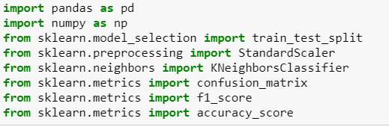
KNN - Predict diabetes
Import the required Scikit-learn libraries as shown:

Slide 45
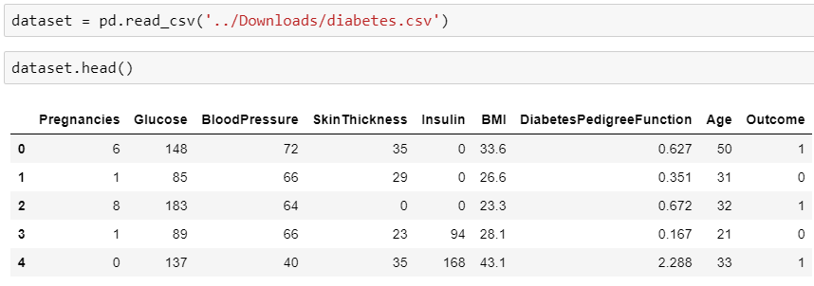
KNN - Predict diabetes
Load the dataset and have a look:

Slide 46
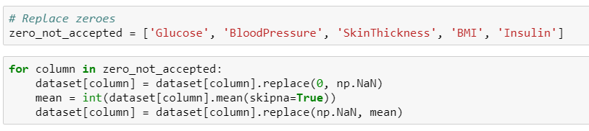
KNN - Predict diabetes
Values of columns like ‘Glucose’, BloodPressure’ cannot be accepted as zeroes because it will affect the outcome
We can replace such values with the mean of the respective column:

Slide 47
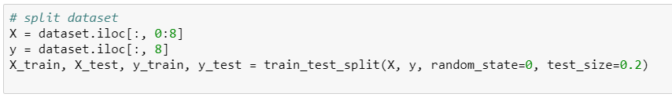
KNN - Predict diabetes
Before proceeding further, let’s split the dataset into train and test:

Slide 48
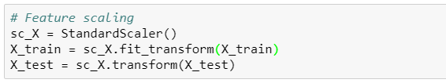
KNN - Predict diabetes
Rule of thumb: Any algorithm that computes distance or assumes normality, scale your features!
Feature Scaling:
Notes:
Most of the times, your dataset will contain features highly varying in magnitudes, units and range. we need to bring all features to the same level of magnitudes. This can be acheived by scaling

Slide 49
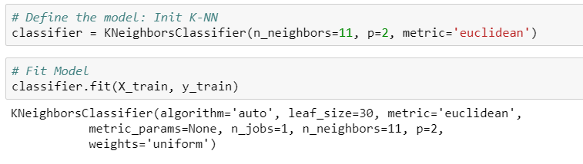
KNN - Predict diabetes
N_neighbors here is ‘K’
p is the power parameter to define the metric used, which is ‘Euclidean’ in our case
Then define the model using KNeighborsClassifier and fit the train data in the model

Slide 50
KNN - Predict diabetes
There are other metrics also to evaluate the distance like Manhattan distance , Minkowski distance etc

Slide 51
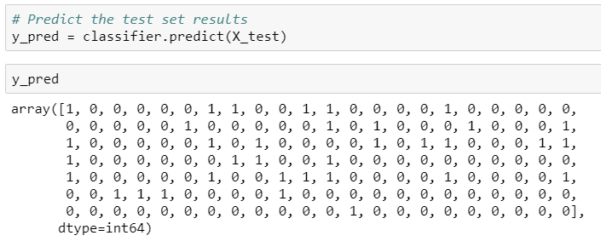
KNN - Predict diabetes
Let’s predict the test results:

Slide 52
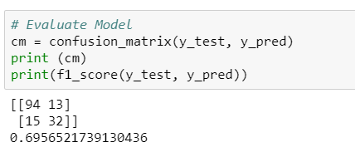
KNN - Predict diabetes
It’s important to evaluate the model, let’s use confusion matrix to do that:
Notes:
The F₁ score is the harmonic average of the precision and recall, where an F₁ score reaches its best value at 1 (perfect precision and recall) and worst at 0.

Slide 53
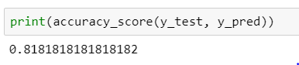
KNN - Predict diabetes
Calculate accuracy of the model:

Slide 54

KNN - Predict diabetes
So, we have created a model using KNN which can predict whether a person will have diabetes or not

Slide 55
KNN - Predict diabetes
And accuracy of 80% tells us that it is a pretty fair fit in the model!

Slide 56

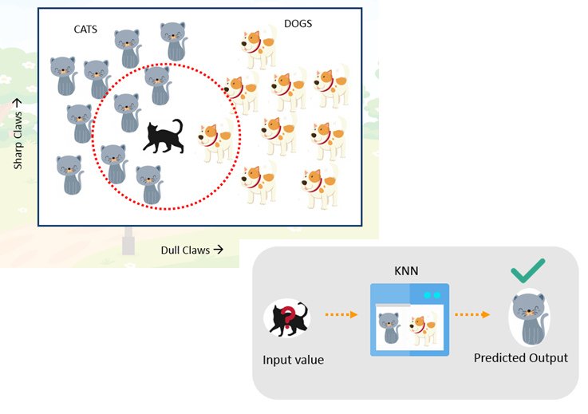
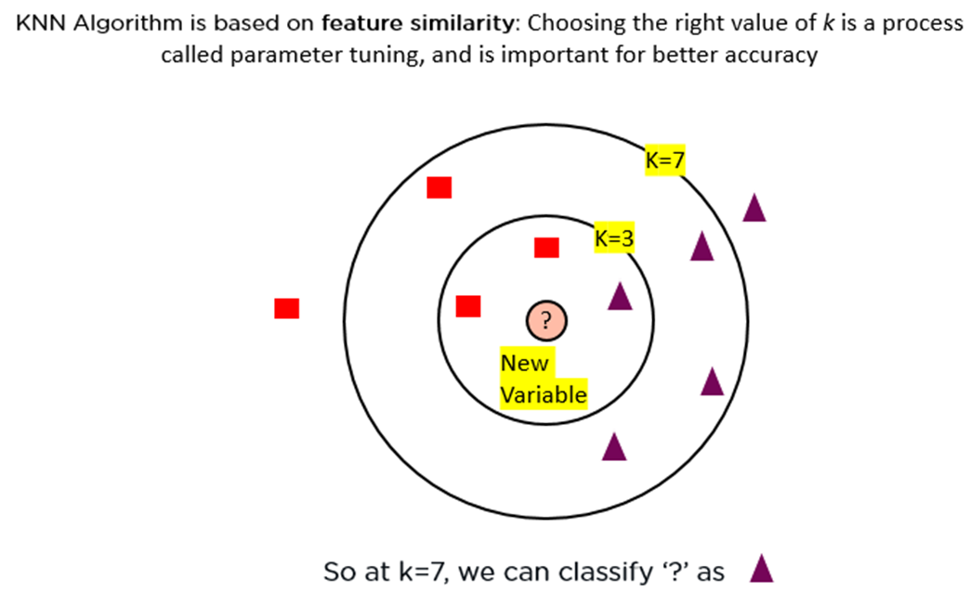
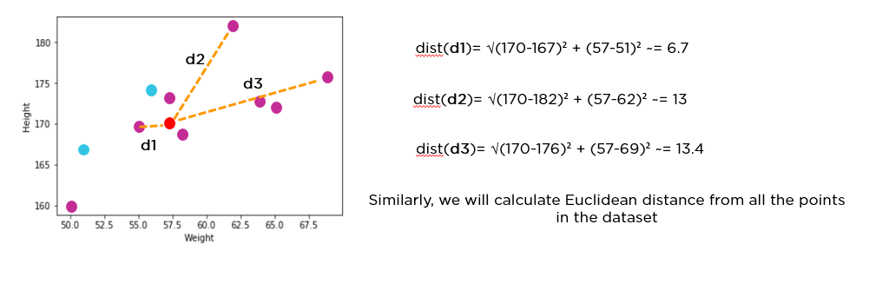
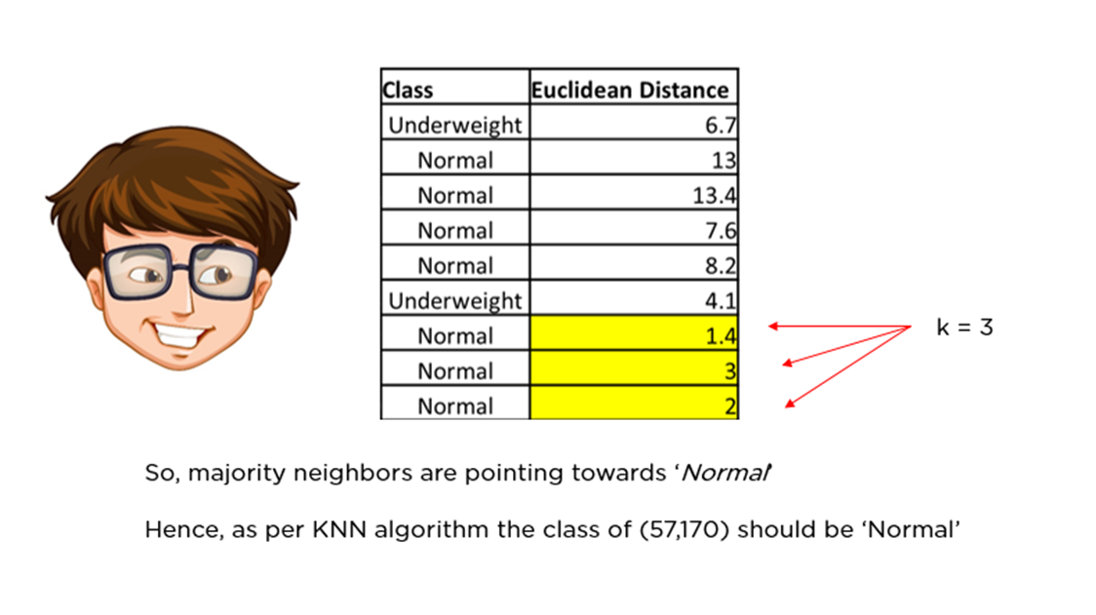
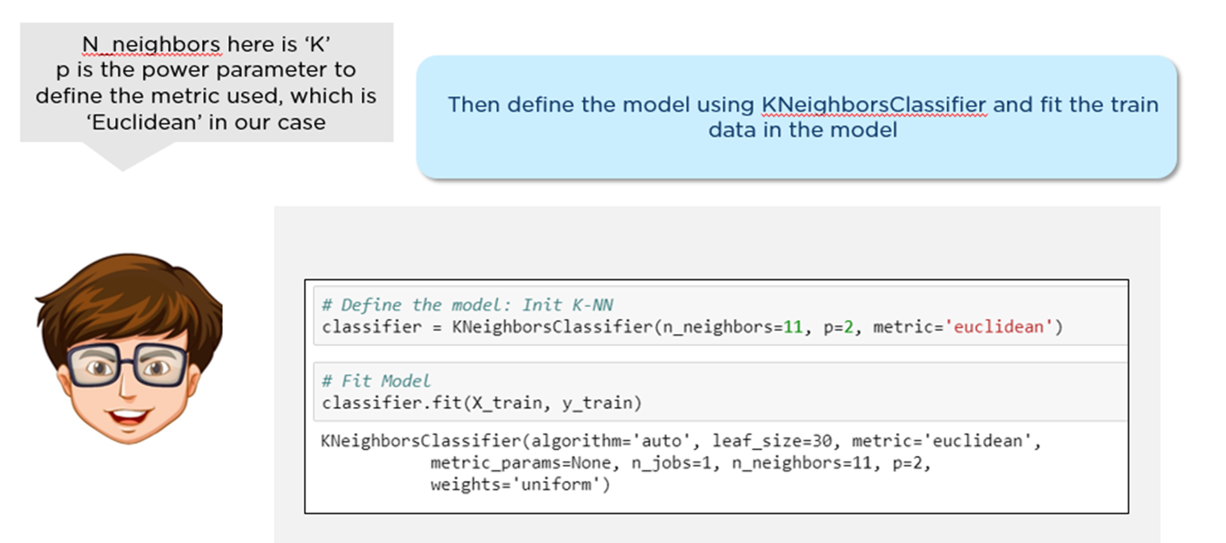
Summary
Why we need knn?
Eucledian distance
Choosing the value of k
How KNN works?
Knn classifier for diabetes prediction

Slide 57


